Slide 1

Introduction to Data Science (IDS201)
Torrens University Australia
Lecturer/Learning Facilitator: Dr. Farshid Keivanian

Slide 2
Week 2 (Module 2): Data Science Lifecycle and Ecosystem
1. Introduction to the Data Science Lifecycle
2. Description of the Data Science Lifecycle
3. Multiple-Choice Questions
4. Exercise
5. An Overview of Assessments
6. Learning Activities

Slide 3
1. Introduction to the Data Science Lifecycle
The data science lifecycle is a systematic framework guiding data scientists from project initiation to completion. It ensures a structured approach to solving data-related problems, emphasizing the iterative nature of refining strategies to meet business objectives.

Slide 4
1. Introduction to the Data Science Lifecycle
Key Points:
1. Identifying the Business Problem: Ensures alignment with business goals.
2. Data Collection and Cleaning: Essential for data quality and relevance.
3. Exploration and Analysis: Helps uncover patterns and insights.
4. Model Building and Validation: Allows testing predictive models.
5. Deployment and Monitoring: Ensures models generate real value and continue to perform well over time.

Slide 5
Open-Ended Question
Can anyone describe what steps you think are involved in the lifecycle of a data science project and why each step might be important?
I believe the data science lifecycle includes several key steps such as identifying the business problem, collecting data, cleaning and preparing the data, exploring and analyzing the data, building and validating models, deploying the models, and finally, monitoring and maintaining them. Each step is crucial because:

Slide 6
Open-Ended Question
1. Identifying the Business Problem: It ensures that we are solving the right issue that aligns with business goals.
2. Collecting Data: We need the right data to analyze and make informed decisions.
3. Cleaning and Preparing Data: This step is vital to ensure the data's quality and relevance.
4. Exploring and Analyzing Data: Helps us uncover patterns and insights.
5. Building and Validating Models: Allows us to create and test predictive models.
6. Deploying Models: We need to put our models into production to generate real value.
7. Monitoring and Maintaining: Ensures that the models continue to perform well over time.

Slide 7
Follow-Up Questions
Question: Can you give an example of a business problem that a company in Sydney might want to solve using data science?
Sample Answer: A retail company in Sydney might want to solve the problem of predicting customer churn to develop better retention strategies. They would need to identify key factors that influence customer churn, collect data on customer interactions, purchase history, and possibly even social media sentiment, then build a model to predict which customers are at risk of leaving.

Slide 8
Follow-Up Questions
Question: Why is it important to clean and prepare data before analysis, and what challenges might you face during this process?
Cleaning and preparing data is essential because raw data often contains errors, missing values, and inconsistencies that can lead to incorrect conclusions. Some challenges include dealing with incomplete data, outliers, duplicate records, and ensuring data is in a usable format. For example, in Sydney's public transportation system, data might come from various sources like ticketing systems, GPS data, and customer feedback, all of which need to be harmonized and cleaned for accurate analysis.

Slide 9
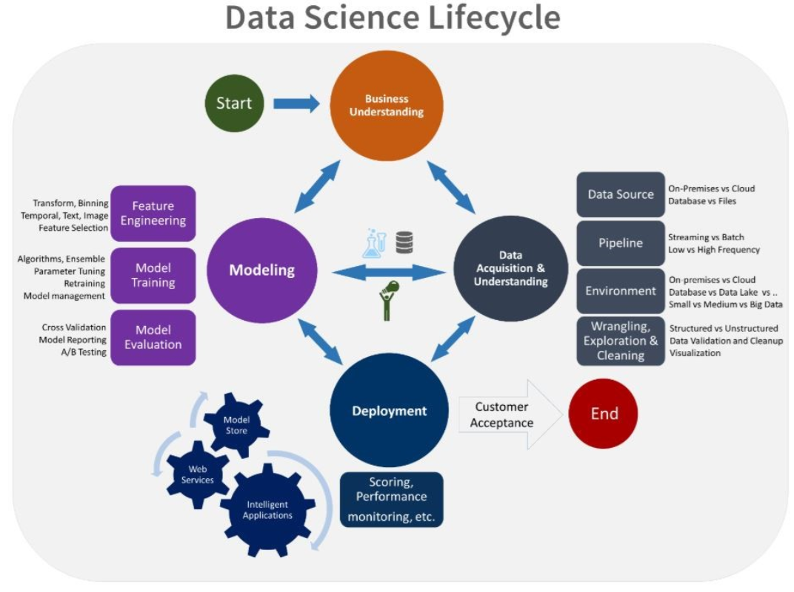
Practical Application of the Data Science Lifecycle
Understanding the data science lifecycle can significantly enhance business decision-making by providing a structured approach to extracting valuable insights from data. In a practical setting, such as a retail company in Sydney, this lifecycle can help streamline operations, improve customer experience, and increase profitability.

Slide 10
Open-Ended Question:
How can understanding the data science lifecycle enhance business decision-making in a practical setting, such as a retail company in Sydney, Australia?
Understanding the data science lifecycle can significantly enhance business decision-making by providing a structured approach to extracting valuable insights from data. In a practical setting, such as a retail company in Sydney, this lifecycle can help streamline operations, improve customer experience, and increase profitability.

Slide 11
Open-Ended Question:
Practical Example: Consider a retail company in Sydney that wants to optimize its inventory management and improve sales forecasting. By following the data science lifecycle:
Business Understanding: The company identifies its main goal: to reduce inventory costs while ensuring products are always in stock to meet customer demand.
Data Acquisition & Understanding: The company collects data from various sources, such as sales transactions, customer demographics, and market trends. They also gather data from online sales and in-store purchases.

Slide 12
Open-Ended Question:
Wrangling, Exploration & Cleaning: The collected data is cleaned and preprocessed to ensure accuracy. This includes removing duplicates, handling missing values, and transforming data into a suitable format.
Feature Engineering: Relevant features are selected, such as seasonal trends, promotional impacts, and customer purchasing behavior. Temporal features like holidays and weather conditions that might affect sales are also included.
Modeling: Various predictive models are developed to forecast future sales. Techniques like time series analysis, regression models, and machine learning algorithms are applied to identify patterns and trends.

Slide 13
Open-Ended Question:
Model Evaluation: The models are evaluated using historical data to ensure accuracy and reliability. Metrics such as Mean Absolute Error (MAE) and Root Mean Squared Error (RMSE) are used to compare model performance.
Deployment: The best-performing model is deployed into a production environment. The company integrates this model with its inventory management system to provide real-time recommendations on stock levels.
Scoring, Performance Monitoring: The deployed model is continuously monitored to ensure it performs well over time. Regular updates and retraining are done based on new data to maintain accuracy.

Slide 14
Open-Ended Question:
By following this lifecycle, the retail company can make data-driven decisions to manage inventory effectively, reduce overstock and stockouts, and ultimately improve customer satisfaction and profitability. For example, the model might predict a surge in demand for certain products during the holiday season, prompting the company to adjust its inventory levels accordingly.

Slide 15
2. Description of the Data Science Lifecycle
The data science lifecycle comprises several distinct phases:
1. Discovery Phase (Define the Business Objective)
Framing the Problem: Framing the problem is the foundational step in the data science lifecycle. It involves understanding and defining the business or research problem that the project aims to solve. This step is crucial because it sets the direction for all subsequent activities. A well-defined problem statement helps to align the project's objectives with the overall goals of the organization or the specific research questions being addressed.

Slide 16
2. Description of the Data Science Lifecycle
Real-World Example: Consider a retail company looking to increase its sales. If the problem is framed as "increase sales," the project might focus broadly on various aspects, such as marketing strategies, product placements, or customer engagement. However, if it's more specifically framed as "increase online sales through personalized recommendations," the project now has a clear direction focusing on data related to customer preferences, online shopping behavior, and product matching algorithms. This shows how defining the objective shapes the project's scope and the analytical methods used.

Slide 17
2. Description of the Data Science Lifecycle
Identifying the Key Stakeholders
Identifying key stakeholders is about recognizing all parties with a vested interest in the project's outcome. Stakeholders can include executives, project managers, marketing teams, customers, and even regulatory bodies. Understanding who the stakeholders are is essential for several reasons:
It helps tailor the project's success criteria to meet stakeholders' expectations.
It ensures that the project requirements are comprehensive and consider all business aspects.
It facilitates effective communication throughout the project, ensuring that feedback and insights from various perspectives are incorporated into the decision-making process.

Slide 18
2. Description of the Data Science Lifecycle
For instance, in a project aimed at reducing customer churn, stakeholders might include the customer service team, which can provide insights into common complaints; the sales team, which understands customer needs; and the IT department, which ensures the data infrastructure supports the analysis.

Slide 19
2. Description of the Data Science Lifecycle
Identifying the Potential Data Sources
This step involves determining where the necessary data can be sourced from, assessing its relevance to the problem at hand, and understanding the challenges related to accessing and using this data. Data sources can be internal, such as sales records, customer databases, and interaction logs, or external, like social media, public datasets, and third-party data providers.

Slide 20
2. Description of the Data Science Lifecycle
Strategies for assessing data sources include:
Evaluating the quality and completeness of the data to ensure it can support the analysis needed.
Considering the ethical and legal implications of using the data, especially with respect to privacy concerns and data protection regulations.
Understanding the technical aspects of data integration, such as compatibility with existing systems and the need for data cleaning and preprocessing.

Slide 21
2. Description of the Data Science Lifecycle
Example: For a project aiming to improve supply chain efficiency, potential data sources might include internal inventory management systems, supplier databases, and external market trend reports. Assessing these sources involves ensuring the data is current, accurate, and detailed enough to identify bottlenecks or inefficiencies in the supply chain process.
In summary, the Discovery Phase is about setting a clear direction for the project by understanding the problem, knowing who has a stake in its success, and identifying where to get the data that will inform your analysis. This phase lays the groundwork for all subsequent steps in the data science lifecycle, ensuring that efforts are aligned with the project's goals and are based on solid, accessible data foundations.

Slide 22
2. Description of the Data Science Lifecycle
The data science lifecycle comprises several distinct phases:
2. Data Acquisition & Preparation Phase
The Data Acquisition and Preparation Phase is a critical step in the data science lifecycle that directly impacts the quality of insights derived from data analysis. This phase involves two major components: acquiring the necessary data and preparing it for analysis. Let’s delve into each aspect:
Data Acquisition is the process of identifying and gathering the required datasets for your project. This step can involve collecting data from various sources, including internal databases (such as sales records or customer interactions), external sources (like social media platforms, public datasets, or third-party data providers), and even real-time data streams.

Slide 23
2. Description of the Data Science Lifecycle
The data science lifecycle comprises several distinct phases:
2. Data Acquisition & Preparation Phase
Methods for Identifying and Gathering Datasets:
Internal Sources: Utilize SQL queries to extract data from company databases, ensuring you have access to accurate and relevant information.
External Sources: Use APIs (Application Programming Interfaces) to collect data from external websites or platforms, or download datasets from public repositories.
Real-time Data Streams: Implement data streaming tools to capture live data, useful in projects requiring up-to-the-minute data, like fraud detection or social media monitoring.

Slide 24
2. Description of the Data Science Lifecycle
The data science lifecycle comprises several distinct phases:
2. Data Acquisition & Preparation Phase
Common Challenges:
Ensuring data quality and relevance to the project goals.
Dealing with large volumes of data, requiring efficient storage and processing capabilities.
Navigating legal and ethical considerations, particularly when dealing with personal or sensitive information.

Slide 25
2. Description of the Data Science Lifecycle
The data science lifecycle comprises several distinct phases:
2. Data Acquisition & Preparation Phase
Data Preparation
Once data is acquired, it needs to be prepared or "cleaned" to ensure it is suitable for analysis. Data preparation can include handling missing values, removing duplicates, correcting errors, and transforming data into a usable format.

Slide 26
2. Description of the Data Science Lifecycle
The data science lifecycle comprises several distinct phases:
2. Data Acquisition & Preparation Phase
Techniques and Tools:
Cleaning Data: Identify and address issues like missing values, outliers, and inconsistencies using Python or R libraries such as pandas or dplyr.
Data Transformation: Convert data into the necessary format for analysis, which may include normalizing scales, encoding categorical variables, or creating new variables through feature engineering.
Integration: Combine data from multiple sources to create a comprehensive dataset, using tools like SQL for database merges or pandas in Python for joining tables.

Slide 27
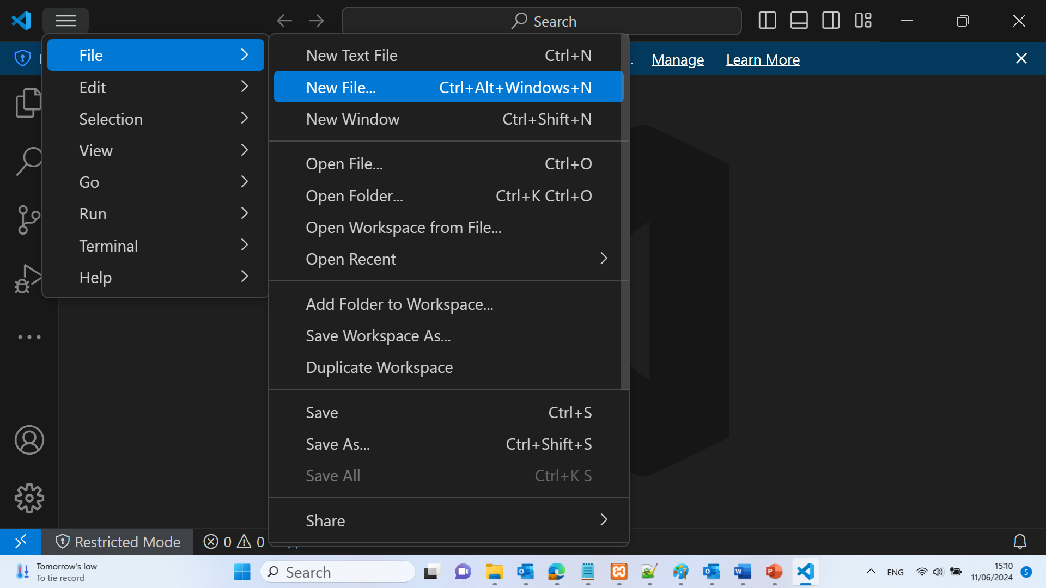
A programming example
Data Exploration and Cleaning
Import the Data: Use Python libraries like pandas to import the CSV file.

Slide 28
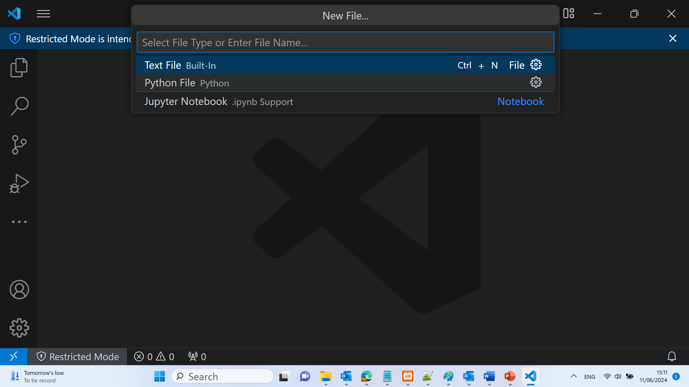
A programming example

Slide 29
A programming example
import pandas as pd
df = pd.read_csv('Telco-Customer-Churn.csv')

Slide 30
A programming example
Initial Data Exploration: Perform initial exploration to understand the data.
print(df.head())
print(df.info())
print(df.describe())

Slide 31
A programming example
Handling Missing Values: Identify and handle any missing values in the dataset.
df.isnull().sum()
df.dropna(inplace=True) # Example of dropping rows with missing values
df.isnull().sum(): Identifies the number of missing values in each column of the DataFrame.
df.dropna(inplace=True): Removes rows with any missing values from the DataFrame.
By using these steps, we can effectively identify and handle missing values in your dataset, ensuring cleaner and more reliable data for our analysis.

Slide 32
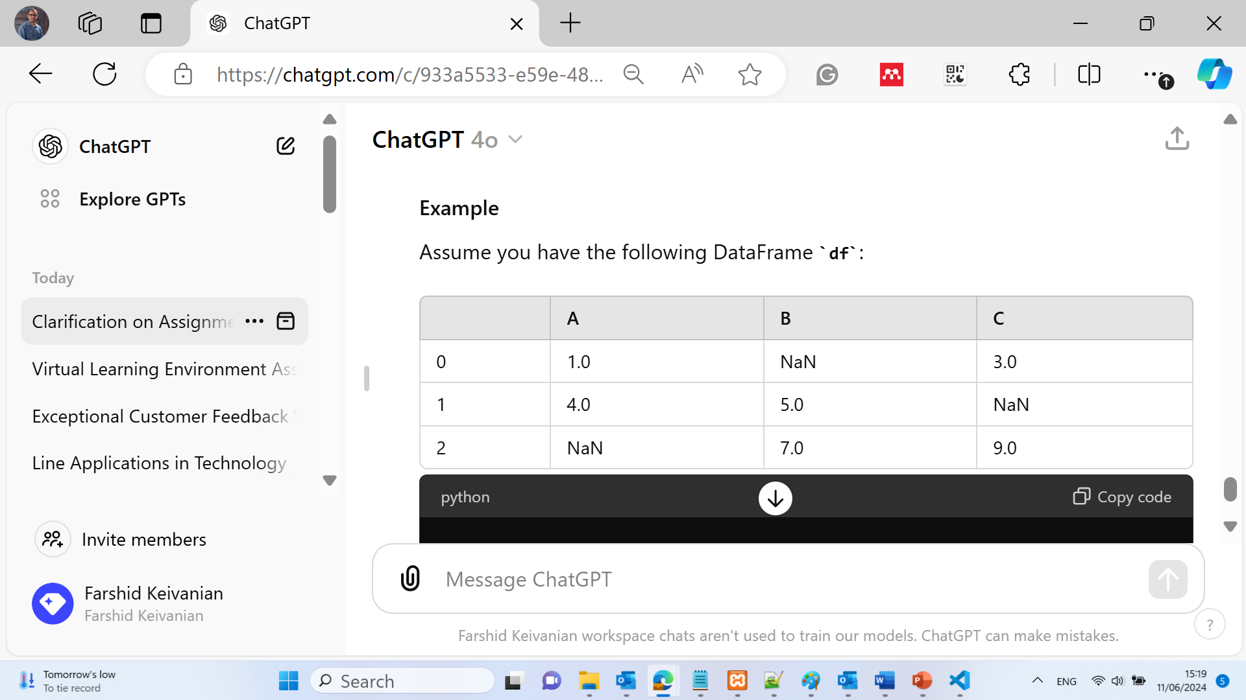
A programming example
Assume we have the following DataFrame df:
import pandas as pd
import numpy as np
data = {'A': [1, 4, np.nan], 'B': [np.nan, 5, 7], 'C': [3, np.nan, 9]}
df = pd.DataFrame(data)
print(df.isnull().sum())

Slide 33
A programming example
Assume we have the following DataFrame df:
A 1
B 1
C 1
dtype: int64
import pandas as pd
import numpy as np
data = {'A': [1, 4, np.nan], 'B': [np.nan, 5, 7], 'C': [3, np.nan, 9]}
df = pd.DataFrame(data)
print(df.isnull().sum())

Slide 34
A programming example
df.dropna(inplace=True)
In this example, all rows contain at least one NaN value. This line removes rows with any missing values from the DataFrame.

Slide 35
A programming example
Handle Data Anomalies: Check for and handle anomalies, such as incorrect data types or outliers.
df['TotalCharges'] = pd.to_numeric(df['TotalCharges'], errors='coerce')
df.fillna(df.mean(), inplace=True) # Example of filling missing values with column mean
This line converts the TotalCharges column in the DataFrame df to a numeric type. If there are any non-numeric values in this column, they will be replaced with NaN (Not a Number).
df.mean(): Computes the mean of each column in the DataFrame df. When used inside fillna(), it specifies that NaN values should be replaced with the mean of their respective columns.

Slide 36
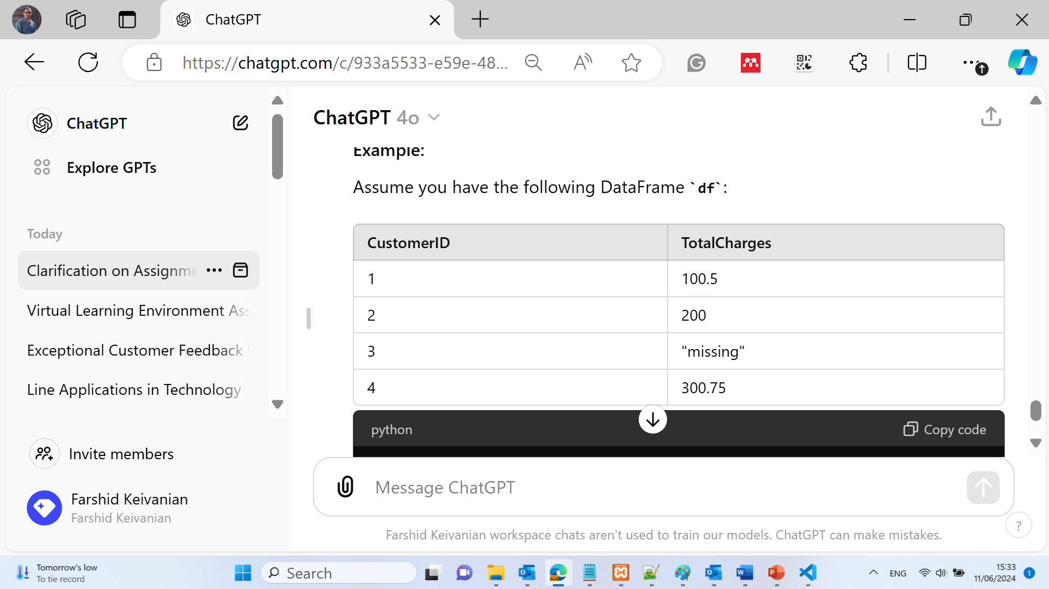
A programming example
Assume we have the following DataFrame df:
import pandas as pd
data = {'CustomerID': [1, 2, 3, 4], 'TotalCharges': ['100.5', '200', 'missing', '300.75']}
df = pd.DataFrame(data)
df['TotalCharges'] = pd.to_numeric(df['TotalCharges'], errors='coerce')
print(df)

Slide 37
A programming example
We will have this:
CustomerID TotalCharges
0 1 100.50
1 2 200.00
2 3 NaN
3 4 300.75
In this example, the string "missing" in the TotalCharges column is converted to NaN.

Slide 38
A programming example
We will have this:
df.fillna(df.mean(), inplace=True)
print(df)
This line fills any missing values (NaN) in the DataFrame df with the mean of their respective columns.
Functionality:
df.fillna(): This function replaces NaN values with a specified value.
df.mean(): Computes the mean of each column in the DataFrame df. When used inside fillna(), it specifies that NaN values should be replaced with the mean of their respective columns.
inplace=True: Modifies the original DataFrame df in place, meaning the changes are applied directly to df rather than returning a new DataFrame.

Slide 39
A programming example
We will have this:
CustomerID TotalCharges
0 1 100.500000
1 2 200.000000
2 3 200.416667
3 4 300.750000
In this example, the missing value (NaN) in the TotalCharges column is replaced with the mean of the TotalCharges column, which is (100.5 + 200 + 300.75) / 3 = 200.416667.
By using these steps, you ensure that the TotalCharges column contains numeric values and handle any missing data by replacing it with the column mean, leading to cleaner and more reliable data for analysis.

Slide 40
2. Description of the Data Science Lifecycle
The data science lifecycle comprises several distinct phases:
2. Data Acquisition & Preparation Phase
Data Exploration and Variable Selection
Following data preparation, exploratory data analysis (EDA) is conducted to uncover patterns, anomalies, or relationships within the data, guiding the selection of relevant variables for the analysis.

Slide 41
2. Description of the Data Science Lifecycle
The data science lifecycle comprises several distinct phases:
2. Data Acquisition & Preparation Phase
Techniques for EDA:
Visualizations: Use plots and charts (e.g., histograms, scatter plots, box plots) to visually explore data distributions and relationships between variables. Tools like Matplotlib and Seaborn in Python, or ggplot2 in R, are commonly used.
Statistical Summaries: Apply descriptive statistics (mean, median, standard deviation) and correlation analyses to summarize data characteristics and identify potential variables of interest.
Dimensionality Reduction: Techniques such as Principal Component Analysis (PCA) can be used to identify the most informative features, reducing the number of variables to consider in the analysis.

Slide 42
2. Description of the Data Science Lifecycle
The data science lifecycle comprises several distinct phases:
2. Data Acquisition & Preparation Phase
Role of Visualizations and Statistical Summaries:
Visualizations provide an intuitive way to identify trends, outliers, and patterns that might not be evident from raw data alone.
Statistical summaries offer a concise overview of the data's properties, helping to inform decisions about which variables might be most relevant for the project's objectives.
In summary, the Data Acquisition and Preparation Phase is foundational to the data science lifecycle, involving meticulous processes to collect, clean, and explore data. By leveraging appropriate methods, challenges, and tools for data acquisition and preparation, and employing effective EDA techniques, data scientists can ensure their datasets are primed for generating meaningful, actionable insights.

Slide 43
2. Description of the Data Science Lifecycle
The data science lifecycle comprises several distinct phases:
3. Model Planning & Building Phase
Model Planning
Model planning is the strategic step where data scientists decide on the modeling techniques to employ based on the project's objectives, the nature of the data, and the insights or predictions they aim to derive. This step requires a deep understanding of the problem statement to select the most appropriate modeling approach that aligns with the project goals.

Slide 44
2. Description of the Data Science Lifecycle
The data science lifecycle comprises several distinct phases:
3. Model Planning & Building Phase
Exploring Various Modeling Techniques:
For predictive models, techniques can range from simple linear regression for continuous outcomes to logistic regression for binary outcomes.
For classification problems, decision trees, random forests, or support vector machines might be more appropriate.
Clustering and dimensionality reduction techniques (like K-means clustering or PCA) are useful for exploratory data analysis to identify patterns or groupings within the data.

Slide 45
2. Description of the Data Science Lifecycle
The data science lifecycle comprises several distinct phases:
3. Model Planning & Building Phase
Importance of Selecting the Right Approach:
The choice of modeling technique directly impacts the model's performance, interpretability, and the feasibility of deployment.
Complex models (like deep learning networks) may offer higher accuracy but require more data and computational resources, and may be less interpretable.
Simpler models may be preferable in scenarios where transparency and ease of explanation are critical.

Slide 46
2. Description of the Data Science Lifecycle
The data science lifecycle comprises several distinct phases:
3. Model Planning & Building Phase
Modeling
After planning, the next step is to apply the selected statistical or machine learning models to the data. This stage involves training models using the prepared datasets, tuning parameters to optimize performance, and validating the models to ensure they generalize well to unseen data.

Slide 47
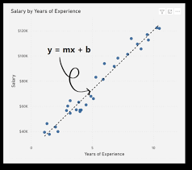
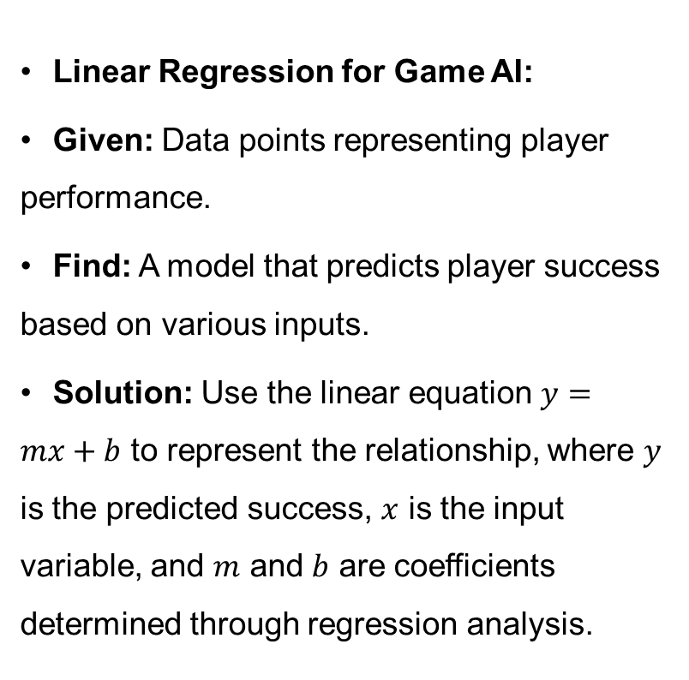
A practical example
Linear Regression for Game AI:
Given: Data points representing player performance.
Find: A model that predicts player success based on various inputs.
Solution: Use the linear equation $y=mx+b$ to represent the relationship, where $y$ is the predicted success, $x$ is the input variable, and $m$ and $b$ are coefficients determined through regression analysis.

Slide 48
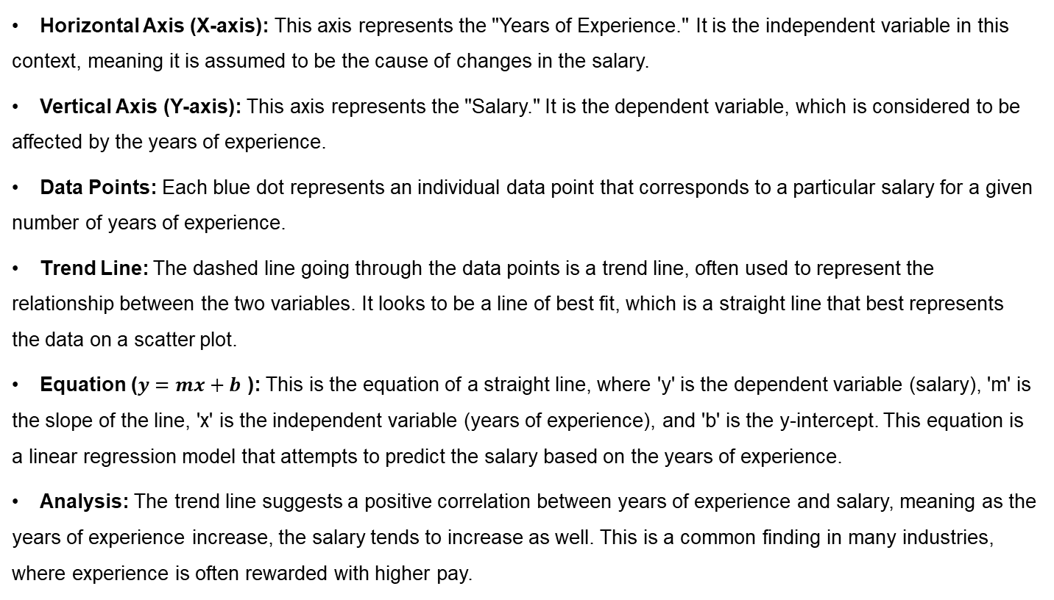
A practical example
Horizontal Axis (X-axis): This axis represents the "Years of Experience." It is the independent variable in this context, meaning it is assumed to be the cause of changes in the salary.
Vertical Axis (Y-axis): This axis represents the "Salary." It is the dependent variable, which is considered to be affected by the years of experience.
Data Points: Each blue dot represents an individual data point that corresponds to a particular salary for a given number of years of experience.
Trend Line: The dashed line going through the data points is a trend line, often used to represent the relationship between the two variables. It looks to be a line of best fit, which is a straight line that best represents the data on a scatter plot.
Equation ($y=mx+b$ ): This is the equation of a straight line, where 'y' is the dependent variable (salary), 'm' is the slope of the line, 'x' is the independent variable (years of experience), and 'b' is the y-intercept. This equation is a linear regression model that attempts to predict the salary based on the years of experience.
Analysis: The trend line suggests a positive correlation between years of experience and salary, meaning as the years of experience increase, the salary tends to increase as well. This is a common finding in many industries, where experience is often rewarded with higher pay.

Slide 49
A practical example
The graph is a typical representation used in statistics and data analysis to infer relationships and make predictions. In this case, the graph would allow someone to predict the expected salary for a given amount of experience by finding the corresponding point on the trend line.

Slide 50
2. Description of the Data Science Lifecycle
The data science lifecycle comprises several distinct phases:
3. Model Planning & Building Phase
Common Tools
Python's scikit-learn: Offers a wide range of simple and efficient tools for data mining and data analysis. It is accessible to everybody and reusable in various contexts.
TensorFlow and PyTorch: More suited for building complex models, like deep learning networks. These frameworks provide extensive libraries for designing, training, and validating models with large datasets.

Slide 51
2. Description of the Data Science Lifecycle
3. Model Planning & Building Phase
Considerations for Choosing a Model:
Accuracy vs. Interpretability: Some models, like neural networks, may offer high accuracy but are often considered "black boxes" due to their complexity. In contrast, models like decision trees offer more interpretability but may not always provide the highest accuracy.
Resource Constraints: Consider the computational resources available. Complex models require more computational power and data, which might not be feasible for every project.
Data Characteristics: The nature of the data (size, quality, features) can influence model choice. For example, certain algorithms are better suited for handling missing values, high dimensionality, or non-linear relationships.

Slide 52
2. Description of the Data Science Lifecycle
3. Model Planning & Building Phase
In the Model Planning & Building Phase, integrating insights on exploring various modeling techniques with the practical aspects of applying these models using common tools forms the core of developing predictive or analytical solutions. Selecting the right approach based on the problem statement and applying it effectively is crucial for building models that not only perform well but also align with the project's objectives and constraints.

Slide 53
2. Description of the Data Science Lifecycle
4. Evaluation Phase
The Evaluation Phase is a critical component of the data science lifecycle, where the performance of the models built in the previous phase is rigorously assessed. This phase ensures that the model not only performs well on the training dataset but also generalizes effectively to new, unseen data. It involves using various metrics and validation techniques to measure model performance and is crucial for refining the model to meet the project objectives. Let’s explore this phase in detail:

Slide 54
2. Description of the Data Science Lifecycle
4. Evaluation Phase
Assessing Model Performance Through Metrics
The choice of metrics to evaluate a model depends on the type of problem (e.g., regression, classification) and the specific objectives of the project. Here are some common metrics used:
For Regression Models: Mean Absolute Error (MAE), Mean Squared Error (MSE), and R-squared are standard metrics. MAE gives an average of the absolute errors between predicted and actual values, MSE squares these errors before averaging to penalize larger errors more severely, and R-squared indicates the proportion of the variance in the dependent variable that is predictable from the independent variables.

Slide 55
2. Description of the Data Science Lifecycle
4. Evaluation Phase
Assessing Model Performance Through Metrics
The choice of metrics to evaluate a model depends on the type of problem (e.g., regression, classification) and the specific objectives of the project. Here are some common metrics used:
For Classification Models: Accuracy, Precision, Recall (Sensitivity), F1 Score, and the Area Under the ROC Curve (AUC-ROC) are frequently used. Accuracy measures the proportion of true results (both true positives and true negatives) among the total number of cases examined. Precision and Recall address the model's ability to identify positive instances accurately, with F1 Score providing a balance between Precision and Recall. AUC-ROC represents the model's ability to distinguish between classes.

Slide 56
2. Description of the Data Science Lifecycle
4. Evaluation Phase
Validation Techniques
Validation techniques are employed to ensure that the model performs well not just on the training data but also on unseen data, thereby assessing its generalizability. Common techniques include:
Holdout Method: The dataset is divided into two parts: one for training the model and the other for testing it. This method is straightforward but may not always provide a reliable estimate of model performance if the dataset is not large enough.
Cross-Validation: Typically, k-fold cross-validation is used, where the dataset is divided into k subsets. The model is trained on k-1 subsets and tested on the remaining subset. This process is repeated k times, with each subset used exactly once as the test set. Cross-validation provides a more reliable estimate of model performance across different subsets of the data.

Slide 57
2. Description of the Data Science Lifecycle
4. Evaluation Phase
Importance of the Evaluation Phase
Refining the Model: Based on the performance metrics, adjustments can be made to the model, such as tuning hyperparameters, selecting different features, or even choosing a different modeling technique altogether.
Ensuring Alignment with Project Objectives: This phase ensures that the model meets the specific needs and objectives of the project. For example, in a medical diagnosis application, high recall might be more important than precision to ensure as few false negatives as possible.
Building Trust: Demonstrating that a model performs well according to relevant metrics and validation techniques builds confidence in its predictions, making stakeholders more likely to trust and act on its insights

Slide 58
2. Description of the Data Science Lifecycle
4. Evaluation Phase
In summary, the Evaluation Phase is fundamental to the data science lifecycle, providing a systematic approach to measure, validate, and refine the model’s performance. By carefully selecting appropriate metrics and employing robust validation techniques, data scientists can ensure their models are effective, reliable, and aligned with the project's goals, ultimately leading to more successful outcomes.

Slide 59
2. Description of the Data Science Lifecycle
5. Deployment Phase
The Deployment Phase marks the transition of data science models from the development stage to their use in real-world applications, making the insights generated by these models actionable. This phase involves strategies for implementing the model in a production environment, addressing potential challenges, and adhering to best practices to ensure seamless integration and operation. Let's delve into the key aspects of this phase:

Slide 60
2. Description of the Data Science Lifecycle
5. Deployment Phase
Strategies for Model Deployment
Model Integration: Integrating the model into the existing production environment so that it can interact with other applications and databases. This often involves developing an API (Application Programming Interface) that allows other software to use the model's predictions.
Batch vs. Real-Time Processing: Depending on the application's requirements, models might be deployed for batch processing (processing data in large batches at regular intervals) or real-time processing (providing predictions instantly on demand). The choice affects the architecture and resources required for deployment.

Slide 61
2. Description of the Data Science Lifecycle
5. Deployment Phase
Strategies for Model Deployment
Containerization: Using container technologies like Docker can simplify deployment by packaging the model and its dependencies into a container that can be easily transported and run in any environment, ensuring consistency across development, testing, and production environments.

Slide 62
2. Description of the Data Science Lifecycle
5. Deployment Phase
Challenges in Deployment
Scalability: Ensuring the model can handle the volume of data and number of requests expected in a production environment. This may require optimizing the model or the infrastructure it runs on.
Version Control: Managing different versions of the model and its dependencies can be challenging. It's essential to have a system in place for versioning to roll back changes if needed and ensure reproducibility.
Monitoring and Maintenance: Once deployed, models need to be continuously monitored for performance degradation and updated as necessary based on new data or changing conditions. This requires ongoing maintenance efforts.

Slide 63
2. Description of the Data Science Lifecycle
5. Deployment Phase
Best Practices for Deployment
Automated Testing and Continuous Integration (CI): Implement automated testing of the model and its integration points to catch issues early. CI practices can help in automatically testing and deploying model updates.
Performance Benchmarking: Before deployment, benchmark the model's performance in a staging environment that closely resembles the production environment. This helps identify any potential issues related to scalability or integration.

Slide 64
2. Description of the Data Science Lifecycle
5. Deployment Phase
Best Practices for Deployment
Monitoring and Feedback Loops: Establish mechanisms for monitoring the model's performance in real-time and creating feedback loops that can inform necessary adjustments or retraining. This includes tracking model accuracy, latency, and resource usage.
Documentation and Compliance: Ensure comprehensive documentation of the model, its architecture, and deployment procedures. Also, adhere to relevant regulatory and compliance requirements, especially for applications involving sensitive data.

Slide 65
2. Description of the Data Science Lifecycle
5. Deployment Phase
In summary, the Deployment Phase is crucial for transitioning models from a development setting to real-world applications. By carefully planning the integration, addressing scalability and version control challenges, and adhering to best practices for testing, monitoring, and compliance, organizations can effectively deploy models that enhance decision-making processes and drive value. This phase requires a collaborative effort across data science, IT, and business teams to ensure the deployed models are robust, scalable, and aligned with business objectives.

Slide 66
2. Description of the Data Science Lifecycle
6. Monitoring and Maintenance Phase
After a model is deployed in a production environment, the Monitoring and Maintenance Phase ensures its continued effectiveness and relevance. This phase involves the ongoing process of keeping an eye on the model's performance, updating it to reflect new data or changing conditions, and making necessary adjustments to maintain its accuracy and reliability. Let's explore the critical components of this phase:

Slide 67
2. Description of the Data Science Lifecycle
6. Monitoring and Maintenance Phase
Monitoring the Model's Performance
Continuous monitoring is essential to detect performance degradation over time, which can occur due to changes in the underlying data patterns (often referred to as "concept drift") or external factors affecting the model's predictions. Key aspects include:

Slide 68
2. Description of the Data Science Lifecycle
6. Monitoring and Maintenance Phase
Performance Metrics: Regularly evaluate the model using the same metrics used in the evaluation phase, such as accuracy, precision, recall, or any other relevant measure, to ensure it continues to meet the project's objectives.
Anomaly Detection: Implement anomaly detection systems to identify unexpected model behavior or significant changes in the data being processed, which could indicate issues needing investigation.

Slide 69
2. Description of the Data Science Lifecycle
6. Monitoring and Maintenance Phase
Need for Regular Updates and Adjustments
Models might need updates or adjustments for several reasons, including:
New Data: As new data becomes available, models can be retrained to incorporate this information, ensuring they remain accurate and relevant.
Changing Conditions: In response to changes in the external environment or within the business itself (such as new products, market conditions, or customer behaviors), models may require adjustments to maintain their performance.
Feedback Loops: Incorporate feedback from the model's predictions in the real world to identify areas for improvement. For example, user interactions or expert reviews can provide insights that inform model adjustments.

Slide 70
2. Description of the Data Science Lifecycle
6. Monitoring and Maintenance Phase
Strategies for Maintenance
Maintaining a model in a production environment involves several strategies:
Scheduled Retraining: Set up a regular schedule for retraining the model with new data to ensure it adapts to changes over time. The frequency of retraining depends on the specific application and how quickly the underlying data changes.
Version Control: Maintain versions of the model and its data to manage updates systematically and roll back to previous versions if an update introduces issues.
Automated Monitoring Tools: Utilize automated monitoring tools to track model performance and flag when it deviates from expected ranges, facilitating timely interventions.

Slide 71
2. Description of the Data Science Lifecycle
6. Monitoring and Maintenance Phase
Importance of this Phase
The Monitoring and Maintenance Phase is crucial for several reasons:
Ensuring Continued Relevance: It ensures that the model remains effective and relevant, providing accurate predictions or insights despite changes in data patterns or external conditions.
Optimizing Performance: Continuous monitoring and regular updates allow for the optimization of the model's performance, adjusting to new data and feedback from real-world use.
Risk Management: By identifying and addressing performance issues promptly, organizations can mitigate risks associated with inaccurate predictions or outdated models.

Slide 72
2. Description of the Data Science Lifecycle
6. Monitoring and Maintenance Phase
In summary, the Monitoring and Maintenance Phase is about ensuring that deployed models continue to perform optimally by regularly assessing their performance, updating them with new data, and making necessary adjustments. This ongoing process is vital for maintaining the accuracy, reliability, and relevance of models in a live environment, ultimately supporting sustained decision-making and operational effectiveness.

Slide 73
2. Description of the Data Science Lifecycle
7. Communicate Results Phase
The Communicate Results Phase is the final step in the data science lifecycle, focusing on conveying the findings from the data analysis and modeling efforts to stakeholders. This phase is crucial because, regardless of the sophistication of the models or the depth of the insights generated, their value is realized only when they are effectively communicated and understood by those who need to act on them. This phase involves strategies for presenting data and model insights in a manner that is both understandable and actionable.
Importance of Effective Communication
Effective communication ensures that the insights derived from data science projects drive decision-making and action. It bridges the gap between technical findings and business applications, enabling stakeholders to appreciate the significance of the results and how they impact organizational goals or strategies.

Slide 74
2. Description of the Data Science Lifecycle
7. Communicate Results Phase
Strategies for Presenting Data and Model Insights
Tailor the Communication to the Audience: Adjust the complexity and depth of the information based on the audience's technical background and interests. For business stakeholders, focus on the implications of the findings for business decisions and strategies, rather than the technical details of the models.
Use Visualizations: Graphs, charts, and infographics can make complex data more accessible and engaging. Tools like Tableau, Power BI, or Python libraries such as Matplotlib and Seaborn are effective for creating visual representations of the findings.

Slide 75
2. Description of the Data Science Lifecycle
7. Communicate Results Phase
Strategies for Presenting Data and Model Insights
Develop Comprehensive Reports: Reports should provide a detailed overview of the methodologies used, the analysis conducted, the insights gained, and the recommendations for action. They should be structured to lead the reader through the findings logically, highlighting key points and conclusions.
Deliver Engaging Presentations: Presentations offer an opportunity to engage directly with stakeholders, explain the findings, and discuss their implications. Use slides to summarize key points, show visualizations, and facilitate discussion about the next steps.

Slide 76
2. Description of the Data Science Lifecycle
7. Communicate Results Phase
Best Practices for Communication
Clarity and Simplicity: Use clear, concise language and avoid unnecessary jargon. The goal is to make the insights accessible, not to showcase technical expertise.
Actionable Insights: Focus on providing insights that stakeholders can act upon. Highlight the implications of the findings and suggest concrete steps or decisions that could be taken.
Interactive Elements: Whenever possible, include interactive elements such as dashboards or live demos. This allows stakeholders to explore the data and insights further, fostering a deeper understanding and engagement.
Feedback Loops: Encourage feedback from stakeholders to ensure that the insights meet their needs and to refine the approach for future communications.

Slide 77
2. Description of the Data Science Lifecycle
7. Communicate Results Phase
Importance of this Phase
The Communicate Results Phase is vital for translating data science efforts into real-world impact. By effectively communicating findings, data scientists ensure that their work informs strategic decisions, operational improvements, and other actions that drive the organization forward. This phase reinforces the value of data science within an organization, fostering ongoing support for data-driven initiatives.
In summary, the Communicate Results Phase is about bridging the gap between data science and business application. Through tailored communication, engaging visualizations, comprehensive reports, and interactive presentations, data scientists can ensure that their insights are not just understood but also acted upon, maximizing the impact of their work.

Slide 78
The data science lifecycle is crucial for ensuring that data analysis projects are structured, efficient, and aligned with business goals. It helps data scientists systematically approach complex problems, breaking them down into manageable tasks. This lifecycle also facilitates collaboration among team members with different expertise and ensures that projects are scalable and reproducible.

Slide 79
3. Multiple-Choice Questions
Discovery Phase
MCQ: A Melbourne-based e-commerce company wants to reduce customer churn. What is the first step in the Discovery Phase?
A) Train a predictive model on customer data
B) Identify key stakeholders and define the business objective
C) Deploy a customer feedback survey
D) Analyze sales data trends over the past year

Slide 80
3. Multiple-Choice Questions
2. Data Acquisition & Preparation Phase
MCQ: When gathering data for a Sydney transport improvement project, which method is essential?
A) Focusing solely on social media feedback
B) Using SQL queries to extract data from internal transport databases
C) Implementing a single survey across all transport modes
D) Limiting data sources to reduce complexity

Slide 81
3. Multiple-Choice Questions
3. Data Exploration and Variable Selection
MCQ: What technique is crucial for identifying relevant variables in a dataset concerning Melbourne's water usage patterns?
A) Only considering variables with direct correlations
B) Using visualizations like scatter plots to explore relationships
C) Ignoring outliers in the dataset
D) Relying on assumptions without data exploration

Slide 82
3. Multiple-Choice Questions
4. Model Planning & Building Phase
MCQ: A Sydney-based healthcare provider is developing a model to predict patient readmissions. What is an important consideration in this phase?
A) Using the most complex model available
B) Selecting a model based solely on ease of use
C) Choosing a model that balances accuracy and interpretability
D) Prioritizing model speed over accuracy

Slide 83
3. Multiple-Choice Questions
5. Evaluation Phase
MCQ: For a project predicting real estate prices in Melbourne, what validation technique ensures the model's generalizability?
A) Using the same data for training and testing
B) Applying k-fold cross-validation
C) Ignoring model overfitting concerns
D) Focusing on a single metric for evaluation

Slide 84
3. Multiple-Choice Questions
6. Deployment Phase
MCQ: A retail chain in Sydney is deploying a model to optimize stock levels. What strategy is key for successful deployment?
A) Deploying the model once without future updates
B) Using Docker for containerization to ensure consistency
C) Limiting the model to batch processing regardless of the need
D) Avoiding API development to reduce complexity

Slide 85
3. Multiple-Choice Questions
7. Monitoring and Maintenance Phase
MCQ: How should a Melbourne-based logistics company ensure its route optimization model remains effective over time?
A) By retraining the model annually, regardless of performance
B) Ignoring model drift until model failure occurs
C) Continuously monitoring performance and updating the model as needed
D) Focusing solely on customer feedback for model adjustments

Slide 86
3. Multiple-Choice Questions
8. Communicate Results Phase
MCQ: What approach should a Sydney environmental agency take to effectively communicate the findings of a pollution study to the public?
A) Use technical jargon to establish credibility
B) Present results through interactive visualizations and clear summaries
C) Limit the findings to academic journals
D) Avoid discussing data limitations or uncertainties

Slide 87
3. Multiple-Choice Questions
9. Example Exercise: Data Preparation
Scenario: A Melbourne-based tourism board collects data from various sources to understand visitor patterns. The dataset includes visitor surveys, hotel bookings, and event attendance records. How should the data be prepared for analysis?
A) Combine and clean the datasets, handling missing values and duplicates.
B) Analyze each dataset separately to simplify the process.
C) Focus solely on hotel bookings as the primary data source.
D) Exclude survey data to avoid subjective information.

Slide 88
3. Multiple-Choice Questions
10. Case Study: Real-Time Processing
Scenario: A Sydney public transportation app wants to implement a model that predicts bus arrival times in real-time. What deployment consideration is most critical for this application?
A) Ensuring the model can only process data in large batches
B) Deploying the model in a way that supports real-time data processing and prediction
C) Using the simplest model to avoid computational overhead
D) Avoiding updates to the model once it is deployed

Slide 89
4. Exercise
Outline a data science project lifecycle for a project aimed at predicting stock prices.
Outlining a data science project lifecycle for a project aimed at predicting stock prices involves navigating through the seven critical phases of the lifecycle, each with its unique challenges and requirements. Here's how each phase would unfold in the context of stock price prediction:
1. Discovery Phase
Framing the Problem: The objective is to develop a predictive model that can forecast future stock prices based on historical data and possibly other relevant factors such as economic indicators or company performance metrics. The goal is to support investment decisions by identifying potential price movements.
Identifying Key Stakeholders: This includes investors, financial analysts, portfolio managers, and regulatory bodies interested in the model's predictions and the methods used to achieve them.
Identifying Potential Data Sources: Essential data sources might include historical stock price data, company financial reports, industry trends, economic indicators, and news articles. Assessing the relevance, quality, and accessibility of data from stock exchanges, financial databases, and news aggregators is crucial.

Slide 90
4. Exercise
Outline a data science project lifecycle for a project aimed at predicting stock prices.
2. Data Acquisition & Preparation Phase
Data Acquisition: Gather historical stock prices, financial statements, and economic indicators from databases like Bloomberg, Reuters, or public datasets. Real-time data might be sourced through APIs provided by financial data providers.
Data Preparation: Clean the collected data for missing values and outliers, normalize price data to account for stock splits and dividends, and engineer features that could influence stock prices, such as moving averages or relative strength index (RSI).

Slide 91
4. Exercise
Outline a data science project lifecycle for a project aimed at predicting stock prices.
3. Data Exploration and Variable Selection
Exploratory Data Analysis (EDA): Use visualizations to understand trends, seasonal patterns, and correlations between stock prices and potential predictors. Statistical summaries will help identify which variables are most strongly associated with stock price movements.
Variable Selection: Choose relevant features for the model, such as lagged stock prices, volume indicators, and economic factors, based on EDA findings and financial theory.

Slide 92
4. Exercise
Outline a data science project lifecycle for a project aimed at predicting stock prices.
4. Model Planning & Building Phase
Model Planning: Evaluate various modeling techniques, from time series models like ARIMA to machine learning approaches such as random forests and neural networks. The choice depends on the project's goals, the nature of the data, and the required prediction accuracy and interpretability.
Modeling: Use Python libraries like scikit-learn for machine learning models or TensorFlow and PyTorch for deep learning models. Factor in considerations like the complexity of the model, the computational resources available, and the need for real-time predictions.

Slide 93
4. Exercise
Outline a data science project lifecycle for a project aimed at predicting stock prices.
5. Evaluation Phase
Assessing Model Performance: Utilize metrics suitable for regression problems, such as MAE, MSE, and R-squared, to evaluate the models. Implement cross-validation techniques to assess the model's ability to generalize to unseen data.
Refinement: Based on evaluation results, refine the model by tuning hyperparameters, selecting different features, or trying alternative modeling techniques to improve prediction accuracy and reliability.

Slide 94
4. Exercise
Outline a data science project lifecycle for a project aimed at predicting stock prices.
6. Deployment Phase
Strategies for Deployment: Integrate the model into a trading platform or investment analysis tool through APIs, ensuring it can provide real-time or updated predictions as new data becomes available. Consider using Docker for containerization to facilitate deployment and scalability.
Challenges and Best Practices: Address scalability to handle large volumes of data and high-frequency predictions. Implement version control and continuous integration/continuous deployment (CI/CD) practices for model updates and maintenance.

Slide 95
4. Exercise
Outline a data science project lifecycle for a project aimed at predicting stock prices.
7. Monitoring and Maintenance Phase
Monitoring: Continuously monitor the model's performance to detect any degradation over time due to changing market conditions or new financial regulations that might affect stock prices.
Maintenance: Regularly update the model with new data and adjust the features or modeling techniques as needed to maintain its accuracy and relevance.

Slide 96
4. Exercise
Outline a data science project lifecycle for a project aimed at predicting stock prices.
8. Communicate Results Phase
Effective Communication: Present the findings and predictions to stakeholders through dashboards, reports, and presentations, making sure to highlight the model's accuracy, reliability, and potential impact on investment strategies.
Actionable Insights: Ensure that the communication emphasizes actionable insights derived from the model's predictions, guiding stakeholders in making informed investment decisions.
By meticulously navigating through each of these phases, the project aimed at predicting stock prices can systematically transform historical data and various indicators into predictive insights, ultimately supporting more informed and strategic investment decisions.

Slide 97

In summary, we outlined a foundational understanding of the data science lifecycle with examples, practical exercises, and multiple-choice questions designed to reinforce learning. The data science life cycle can be tailored to specific challenges, guiding the process from problem definition to solution deployment and ongoing improvement. These concepts are crucial for beginners to grasp as they form the basis of data science and problem-solving in software and AI development.

Slide 98
5. An Overview of Assessments
Assessment 1: Introduction to Data Science Concepts and Data Pipeline Design
Objective: To understand and critically analyze a data-driven scenario (e.g., an online retail business case), identify data sources, address data integration challenges, and design a data storage and retrieval system (data lake).
Skills Developed:
Identifying potential data sources relevant to an organization's objectives.
Addressing challenges in integrating data from various sources.
Designing an efficient data lake using big data tools for storage and retrieval.
Relation to Other Assessments: This initial assessment lays the groundwork by emphasizing the importance of data sources, integration, and the conceptual design of data storage solutions. It sets a theoretical foundation for the practical applications that follow in Assessments 2 and 3.

Slide 99
5. An Overview of Assessments
Assessment 2: Data Science Case Study and Model Development
Objective: To conduct a case study in a chosen domain, identify a specific data science problem, and develop a model to address it using a dataset. This involves data visualization, descriptive statistics, model development (e.g., decision tree model), and handling missing values.
Skills Developed:
Application of data science skills and tools relevant to the chosen domain.
Developing a predictive model and addressing data preprocessing and feature selection.
Ethical considerations in data science projects.
Relation to Other Assessments: Assessment 2 advances from the theoretical understanding in Assessment 1 to applying data science tools and techniques to solve a specific problem. It requires identifying and preparing a dataset that will also be used in Assessment 3, thus directly linking the two.

Slide 100
5. An Overview of Assessments
Assessment 3: Data Analysis and Visualization Report
Objective: To analyze the dataset identified in Assessment 2 using Python, and write a report presenting and discussing the results of the analysis. This includes re-stating the data science problem, describing the analytics approach, statistical methods used, and discussing the analysis results supported by programming code evidence.
Skills Developed:
Data analytics and programming skills in Python.
Ability to report and communicate findings effectively.
Practical application of the analytics approach and statistical methods to solve a real-world data science problem.
Relation to Other Assessments: This final assessment is the practical culmination of the course, where you apply your accumulated knowledge and skills to analyze data and communicate your findings. It builds directly on the dataset and problem identified in Assessment 2, requiring you to perform a detailed analysis and present your insights.

Slide 101
5. An Overview of Assessments
Progression: Each assessment builds on the knowledge and skills developed in the previous one, moving from theoretical understanding and planning (Assessment 1), to applying data science techniques in a case study (Assessment 2), and finally to analyzing data and communicating findings (Assessment 3).
Cohesion: The sequence of assessments is designed to simulate the stages of a real-world data science project, from conception to execution and reporting.
Completeness: By the end of Assessment 3, you will have experienced a comprehensive journey through the key stages of a data science project, including problem identification, data preparation, analysis, and communication of results.
Together, these assessments are structured to ensure that you not only learn theoretical concepts but also apply them in practice, thereby equipping them with the skills needed to tackle data science problems in various domains.

Slide 102
5. An Overview of Assessments
Assessment 1: A) Descriptive Essay (350 words)
Introduction
Elaboration of Data Science: Start with a compelling definition of data science, emphasizing its interdisciplinary nature that combines statistics, computer science, and domain expertise to extract meaningful insights from data. Illustrate with an example, such as how data science has enabled personalized marketing strategies in e-commerce by analyzing customer behavior data.
Roles and Responsibilities: Clearly enumerate the roles of a data scientist, such as data analysis, machine learning model development, and data visualization. For each role, provide a brief example, like using predictive modeling to forecast sales trends.

Slide 103
5. An Overview of Assessments
Assessment 1 - A) Descriptive Essay (350 words)
Body
Challenges: Discuss the challenges in data collection (e.g., data privacy concerns), data cleaning (e.g., handling missing values), ethical issues (e.g., bias in AI), and data storage (e.g., securing big data). Use real-life scenarios to highlight these challenges, such as the ethical dilemma in using personal data without infringing on privacy.
Solution-Oriented Approach: Propose solutions for each challenge, emphasizing critical thinking and innovative approaches. For instance, adopting transparent data collection methods that comply with privacy laws, or using advanced algorithms to detect and mitigate biases in datasets.
Conclusion
Skills for Overcoming Challenges: Conclude by listing essential skills for a data scientist, such as analytical thinking, problem-solving, programming expertise, and ethical judgment. Highlight the importance of continuous learning and adaptability in the fast-evolving field of data science.

Slide 104
5. An Overview of Assessments
Assessment 1 - B) Lifecycle of Data Science and Ecosystem Importance (400 words)
Lifecycle of Data Science (250 words)
Steps Involved: Describe the data science lifecycle, starting from problem identification, through data collection, cleaning, exploration, model building, validation, deployment, and feedback. For each step, provide a concise example, like using natural language processing (NLP) techniques in the model building phase to analyze customer reviews.
Importance of Data Science Ecosystem (150 words)
Ecosystem Components: Highlight the components of the data science ecosystem, including data sources, computational tools (e.g., Python, R), visualization tools (e.g., Tableau, PowerBI), and the community (e.g., GitHub, Stack Overflow).
Ecosystem Value: Explain how the ecosystem supports the data science lifecycle, facilitating collaboration, innovation, and efficiency. Use an example, such as the role of open-source libraries in accelerating model development.

Slide 105
5. An Overview of Assessments
Assessment 1 - Knowledge and Understanding: Your essay should demonstrate a deep understanding of data science, clearly explaining its lifecycle and ecosystem with relevant examples.
Analysis and Application: Analyze the roles, responsibilities, and challenges in data science, applying knowledge to propose solutions and real-life applications.
Effective Communication: Write clearly and concisely, using specialized language appropriately, and keeping the audience engaged. Ensure the essay is well-structured, with logical flow and error-free language.
Correct Citation of Key Resources: Use high-quality, credible sources to support your arguments. Ensure APA referencing is accurate and error-free, demonstrating a wide scope of research.

Slide 106
5. An Overview of Assessments
Assessment 2 - Abstract and Introduction (10%)
Abstract: Summarize the case study, including domain, problem, aims, significance, and analytics approach in under 150 words. Ensure clarity and conciseness.
Introduction: Provide a compelling background of the chosen domain, articulate the data science problem clearly, and state the significance and objectives of the study. For example, if the domain is healthcare, discuss how data science can improve patient outcomes and healthcare efficiency.
Data Science Problem (10%)
Problem Identification: Clearly articulate a specific problem within the chosen domain, such as predicting patient readmission rates in hospitals. Define the scope and how the study addresses this problem, ensuring clarity and conciseness.

Slide 107
5. An Overview of Assessments
For example) A Healthcare Domain Case Study
Abstract: This study explores the application of data science in predicting hospital readmission rates among diabetic patients. By analyzing a compact dataset of patient demographics, health metrics, and readmission instances, we aim to identify key predictors and develop a predictive model. This research holds significant potential for enhancing patient care and reducing healthcare costs.
Introduction: In the healthcare domain, managing hospital readmission rates is crucial for improving patient outcomes and operational efficiency. Data science offers powerful tools for analyzing patterns and predicting future readmissions. This study focuses on diabetic patients, a group particularly vulnerable to complications leading to readmissions.
Data Science Problem: The problem is to predict hospital readmission rates among diabetic patients based on various health metrics and demographics to improve patient care and reduce unnecessary readmissions.

Slide 108
5. An Overview of Assessments
Assessment 2 - Dataset Description (10%)
Dataset Overview: Select a dataset relevant to your domain with 3-10 variables. Describe the dataset in detail, including the source, variables, and its relevance to the problem. For example, a dataset on patient demographics, health metrics, and readmission rates.
Data Science Problem (10%)
Problem Identification: Clearly articulate a specific problem within the chosen domain, such as predicting patient readmission rates in hospitals. Define the scope and how the study addresses this problem, ensuring clarity and conciseness.
Significance and Objectives (10%)
Significance: Discuss the importance of addressing the identified problem, such as improving healthcare outcomes and reducing costs.
Objectives: List specific aims, such as developing a predictive model to identify patients at high risk of readmission.

Slide 109
5. An Overview of Assessments
For example) In A Healthcare Domain Case Study
Dataset Description: The dataset comprises patient records from a local hospital, including age, gender, HbA1c levels, previous hospitalizations, and readmission status within 30 days, totaling nine variables. The dataset's relevance lies in its comprehensive coverage of factors potentially influencing readmissions.
Significance and Objectives: Addressing this problem is significant as it directly impacts patient health outcomes and healthcare cost-efficiency. The study's objective is to develop an accurate predictive model for hospital readmissions among diabetic patients.

Slide 110
5. An Overview of Assessments
Analytics Approach and Statistical Techniques (20%)
Approach: Describe the analytics approach, including data preprocessing, exploratory data analysis, and model selection. For instance, using Python for data cleaning, visualization, and machine learning.
Statistical Techniques: Detail the statistical methods or machine learning algorithms applied, such as logistic regression or random forests, explaining why they are appropriate for the problem.
Ethical Considerations (20%)
Ethical Issues: Highlight potential ethical concerns with the dataset or within the domain, such as patient privacy in healthcare data. Discuss how these issues are addressed, ensuring compliance with ethical standards.
Content Writing (10%)
Clarity and Organization: Write with clear, concise language, organizing the report logically. Use appropriate technical terminology and ensure the report is free from grammatical errors.
Formal English: Employ formal English throughout, maintaining academic integrity and professionalism.
APA Referencing (10%)
In-text Citations and Reference List: Use APA style for all references accurately. Include a variety of high-quality sources, such as academic journals, to support your case study.

Slide 111
5. An Overview of Assessments
For example) In A Healthcare Domain Case Study
Analytics Approach and Statistical Techniques: Our approach includes data cleaning, exploratory data analysis using Python, and applying machine learning algorithms like random forests due to your effectiveness in handling complex, nonlinear relationships among variables.
Ethical Considerations: Ethical concerns include ensuring patient data privacy and informed consent. Data anonymization and ethical review board approval are steps taken to address these issues.
By meticulously addressing each of these points with depth and clarity, and presenting the information logically and coherently, your submission will meet the high distinction criteria for Assessment 2 in the Introduction to Data Science course.

Slide 112
5. An Overview of Assessments
Assessment 3 - Re-state the Data Science Problem and Dataset (15%)
Problem Statement: Clearly reiterate the data science problem identified in Assessment 2. For example, if the problem was predicting customer churn for a telecom company, state this problem again in a concise manner, emphasizing its significance.
Dataset Description: Describe the dataset chosen for the analysis succinctly, mentioning its relevance to the problem and highlighting its key features, such as the number of observations, variables, and the nature of the data (categorical, numerical, etc.).

Slide 113
5. An Overview of Assessments
Assessment 3 - Describe Analytics Approach and Statistical Methods (15%)
Analytics Approach: Briefly outline the analytics approach adopted, for example, data cleaning, exploratory data analysis (EDA), and statistical modeling. Mention the programming languages (Python) and libraries used (pandas, NumPy, matplotlib, scikit-learn).
Statistical Methods: Explain the statistical methods or algorithms applied to address the problem, such as logistic regression for classification. Justify the choice of these methods in the context of the data science problem.

Slide 114
5. An Overview of Assessments
Assessment 3 - Steps Taken for Data Analysis (20%)
Data Analysis Process: Detail all the steps taken to analyze the data, from initial data cleaning and preparation through to EDA and model building. Include the rationale behind each step and how it contributes to solving the data science problem.
Python Code Evidence: Mention that the appendix contains Python code snippets and outputs that evidence these steps, ensuring to comment the code for clarity.

Slide 115
5. An Overview of Assessments
Assessment 3 - Discuss Results (30%)
Results Presentation: Present the key findings from your analysis, including model performance metrics (e.g., accuracy, precision, recall) and insights derived from the data (patterns, trends, anomalies).
Evidence Support: Include tables, graphs, and plots generated from the Python codes to substantiate your results. Ensure these visualizations are clearly labeled and accompanied by brief descriptions explaining what they depict.

Slide 116
5. An Overview of Assessments
Assessment 3 - Programming Source Codes in Python (15%)
Code Documentation: Highlight that your Python source codes are well-commented, making it easy for others to understand the purpose of each section of the code and each function used.
Error-free Codes: Assert that the submitted Python codes are free of compilation and runtime errors, ensuring the reliability of the analysis results.

Slide 117
5. An Overview of Assessments
Assessment 3 - Content Writing (10%)
Writing Quality: Ensure the report is written in a clear, concise, and organized manner, following a logical structure that makes it easy for readers to follow the analysis process and understand the findings.
Grammar and Spelling: Proofread the report to ensure it is free from grammatical errors and spelling mistakes. Use formal English throughout the document.

Slide 118
5. An Overview of Assessments
APA Referencing (10%)
Referencing: Adhere to the APA style (7th) for both in-text citations and the reference list. Ensure that all references are high quality and relevant to the subject matter, such as academic papers, reputable industry reports, and authoritative web resources.

Slide 119
5. An Overview of Assessments
Assessment 3:
Introduction: Restate the data science problem and dataset.
Analytics Approach: Describe the analytics approach and statistical methods used.
Data Analysis Process: Detail the steps taken to analyze the data, supported by Python code snippets in the appendix.
Results Discussion: Present and discuss the analysis results, including visual evidence.
Conclusion: Summarize the key findings and your implications for the data science problem.
Appendices: Include Python code with comments and any additional materials.
References: List all references in APA (7th) format.

Slide 120

6. Learning Activities

